Slide 2
Nurse Licensure Compact
Licensure Solution for US Interstate Nursing Practice
LHA
April 17, 2019

Slide 3
Overview

Slide 4
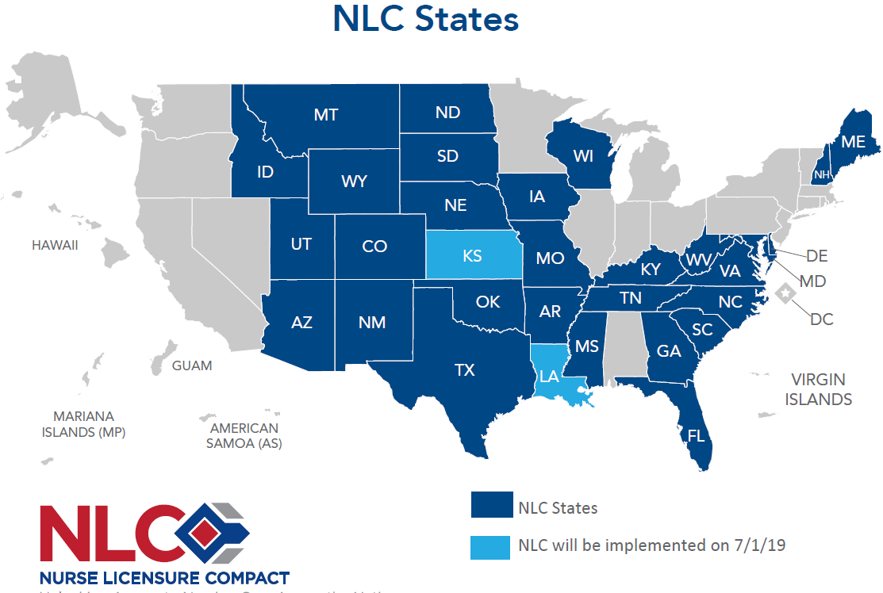
31 States in Which a Nurse Holding a Multistate License can Practice (as of 7/1/19)

Slide 5
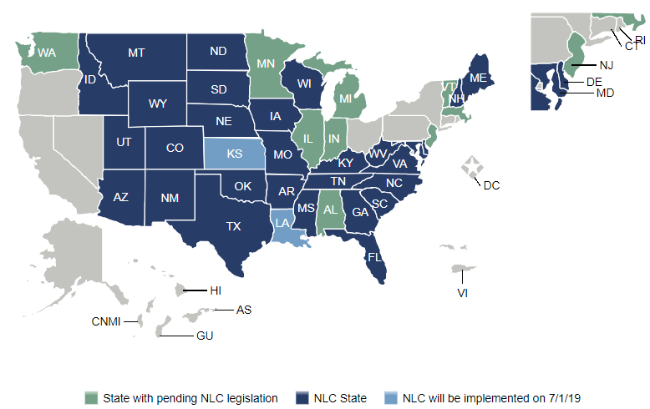

Slide 6
The Licensure Model
Mutual Recognition (Driver’s License Model)
A state-based license
Nationally recognized
Locally enforced

Slide 7
Primary Concepts
Nurse who meets 11 uniform license requirements is issued a multistate license in the declared primary state of residence (PSOR) known as the home state
Nurse holds only one multistate license issued by the home state
The multistate licensure gives the nurse the privilege to practice (PTP) in other Compact states (remote states)

Slide 8
Licensure

Slide 9
How Licensure Works
To obtain a multistate license, a nurse must be a legal resident of a compact state.
While maintaining residency in a compact state, a nurse may practice in any compact state without taking any additional steps.
If a nurse changes primary state of legal residency, then the nurse needs to immediately apply for a license by endorsement in the new state of residency.

Slide 10
How does a Current LA Resident who Holds a LA License Obtain a LA Multistate License?
Starting July 1, 2019, go to the board of nursing website and complete the conversion application and pay the required fee.
RNs go to: www.lsbn.state.la.us
LPNs go to: www.lsbpne.com

Slide 11
How does a Nurse who (does not hold a LA license) and is a New LA Resident or a New Graduate Making LA the PSOR
Obtain a Multistate License?
Starting July 1, 2019, nurses making LA their new primary state of residency and applying for license by endorsement or license by examination will automatically be considered for a LA multistate license.

Slide 12
11 Uniform Licensure Requirements
To receive a multistate license, a nurse must:
Meet the home state’s qualifications
Graduate from qualifying education program (or graduated from a foreign program verified by independent credentials review agency)
Pass the NCLEX-RN® or NCLEX-PN® exam (or state board test pool exam)

Slide 13
Uniform Licensure Requirements (Continued)
To receive a multistate license, a nurse must:
Passed English proficiency exam if a foreign grad
Have no active discipline on a license
Not be currently enrolled in an alternative program
7) Self-disclose participation in an alternative program

Slide 14
Uniform Licensure Requirements (Continued)
To receive a multistate license, a nurse must:
Submit to state/federal fingerprint-based criminal background check
Have no misdemeanors related to practice of nursing as determined by the state board of nursing on a case by case basis
10) Have no prior state or federal felonies
11) Have a Social Security Number
NOTE: A nurse who does not meet a requirement may be eligible to receive a single state license.

Slide 15
Moving Scenarios
(Changing Primary State of Residence, i.e., Changing State of Legal Residency)

Slide 16
How is Primary State of Residence (PSOR) defined?
Signed Declaration of PSOR form (within the application)
State Where Applicant Can Prove Legal Residence
  Drivers license with home address
  Voter registration card with home address

Slide 17
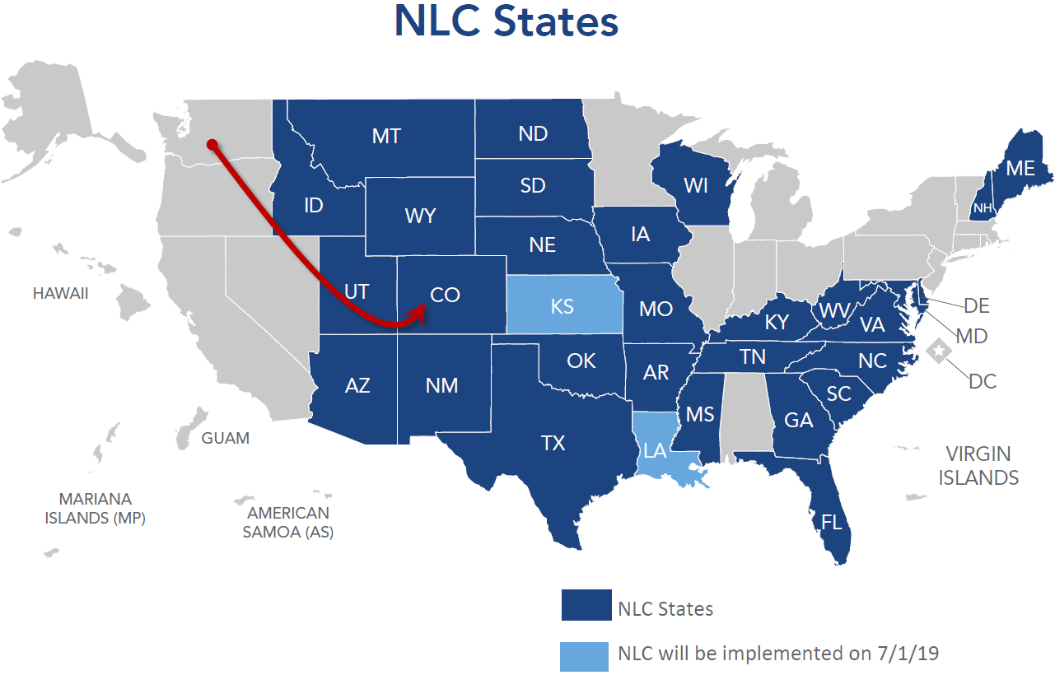

From Non-Compact State to Compact State

Slide 18
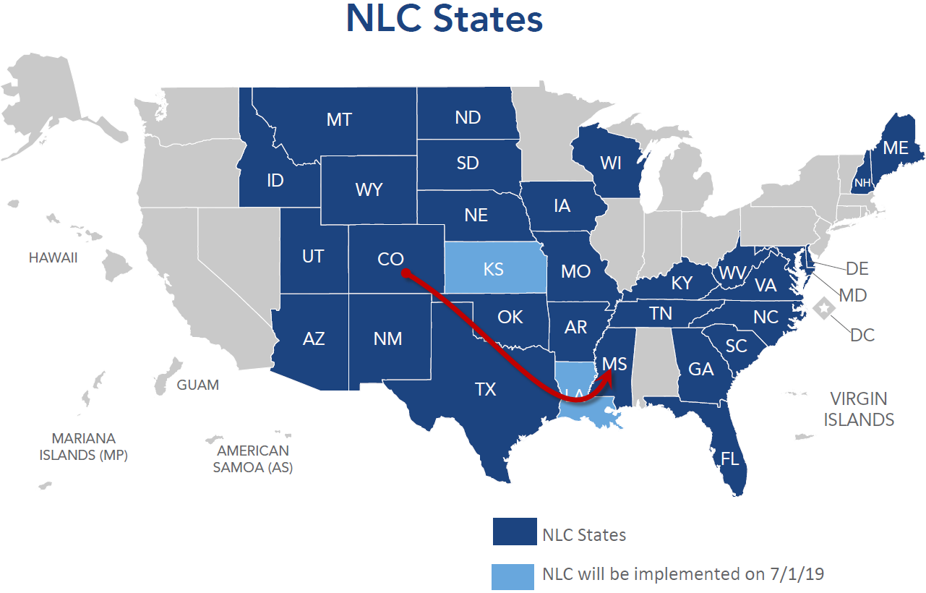
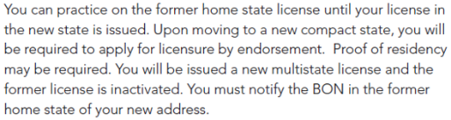
From a Compact State to a Compact State

Slide 19
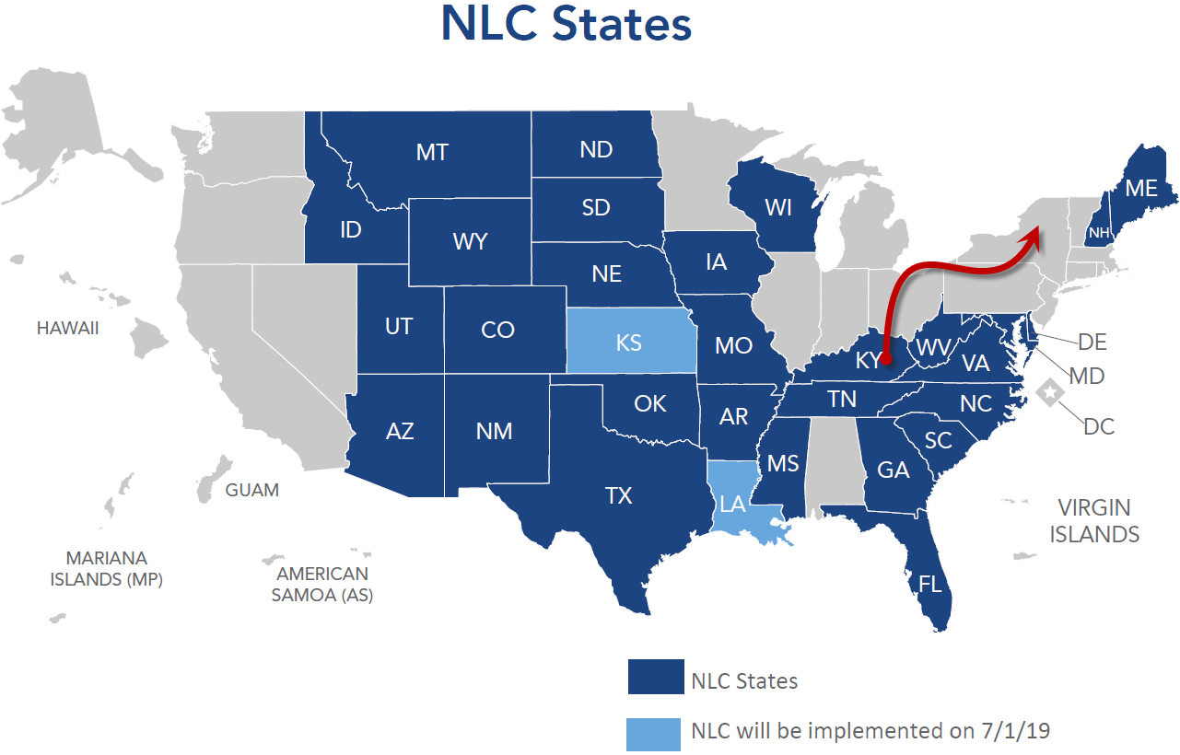
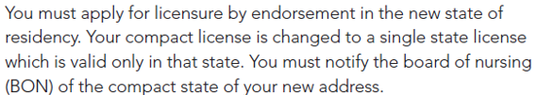
From a Compact State to a Non-Compact State

Slide 20
How Can Hospitals / Employers Best Ensure that Nurses Hired from other NLC States are Appropriately Licensed?
Is the nurse a travel nurse or in a temporary placement whereby the nurse’s PSOR is another compact state? (i.e., the nurse is a visitor to your state and NOT becoming a legal resident. | The nurse can practice in the state under the multistate license issued by the home state/primary state of residence. There is no time limit. A military spouse working in a civilian facility and stationed in your state for several years, would fall in this category.

Slide 21
How Can Hospitals / Employers Best Ensure that Nurses Hired from other NLC States are Appropriately Licensed?
Is the nurse changing PSOR to your state? (The nurse is making a permanent move rather than temporary). | The nurse should immediately apply for license by endorsement in the new state of residence. There is no grace period. (Employers have managed this successfully by implementing a policy whereby the nurse must provide proof of application for licensure to the employer within X number of days of employment.) Exception: You hire a nurse from a neighboring state who commutes daily. The nurse is able to practice in your state under the multistate license issued by the home state.

Slide 22
Resources
See the NLC Toolkit at
https://www.ncsbn.org/nlc-toolkit.htm

Slide 23
Nursys.com
The national nurse licensure database
Employers should confirm a nurse’s authority to practice and license status at nursys.com
Only nursys.com will display discipline on the nurse’s license or PTP from any state.

Slide 24
Discipline

Slide 25
How Discipline Works
A remote state may take adverse action against the licensee’s Privilege to Practice within that remote state.
The home state may take action against the license. The home state’s action removes all multistate privileges. This protects all compact states from the licensee. The license becomes a single state license.

Slide 26
A PTP (Remote State) Discipline Scenario
  Mary is a resident of Texas (a compact state) and holds a Texas multistate license.
  Mary accepts a temporary travel nurse assignment in Louisiana, a compact state.
  While practicing in Louisiana, she violates the Louisiana nurse practice act by diverting controlled substance drugs.
  The hospital reports Mary to the LA BON.

Slide 27
A PTP (Remote State) Discipline Scenario (Cont’d)
  5. LA BON receives the complaint and after a preliminary inquiry, decides that an investigation is warranted.
  6. LA BON conducts the investigation because that is where the violation occurred.
  LA BON turns on the Nurse Alert in the licensee’s Nursys file, as appropriate.
  Since LA is the remote state, LA BON staff notify the licensee’s home state, TX BON, via speed memo or phone that one of their multistate license holders is under investigation in LA.

Slide 28
A PTP (Remote State) Discipline Scenario (Cont’d)
  9. LA BON treats the licensee as if the licensee were a resident of LA, applying its state laws to the case when disciplining the PTP.
  10. At the conclusion of the investigation, LA BON sends the licensee investigative file to TX BON.
  11. TX BON takes action on the multistate license as if the violation occurred in Texas, applying its own state laws. (Texas does not repeat the investigation.)
  12. TX BON converts the multistate license to single state, as appropriate.

Slide 29
Thank you!
Jim Puente, MS, MJ, CAE
Director, Nurse Licensure Compact
nursecompact@ncsbn.org
nursecompact.com
ncsbn.org/nlc

